Slide 1

Basic Details of the Team and Problem Statement
Ministry/Organization Name/Student Innovation :
Department of Social Justice & Empowerment,
Ministry of Social Justice and Empowerment
PS Code : RS926
Problem Statement Title:
Simplifying the process of identifying bright students for Ambedkar Social Innovation & Incubation Mission (ASIIM) Team Name: F E I S T Y C O D E R S Team Leader Name: Lakkakula Sai Harshitha
Institute Code (AISHE): 1-9319813404
Institute Name:
VASIREDDY VENKATADRI INSTITUTE OF TECHNOLOGY
Theme Name: SMART EDUCATION

Slide 2
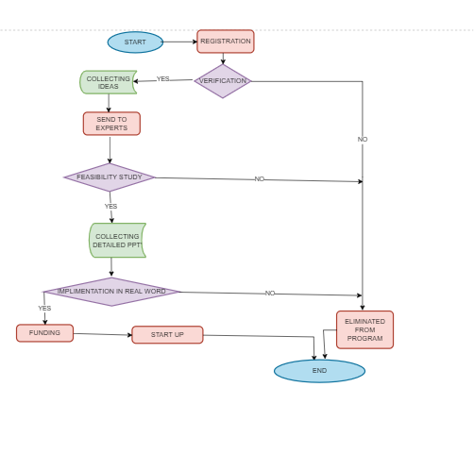
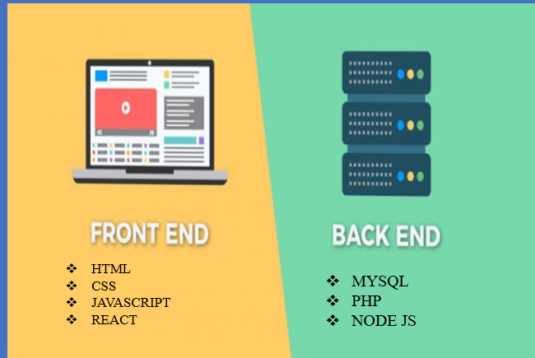
Idea/Approach Details
IDEA PROTOTYPE
Registration
Certificate verification for students under SC category.
Students are shortlisted based on their caste.
Respective link will be send to shortlisted people for creating their own account
Instructions are provided in the link about how to submit and the format of demo pdf.
One should submit their ideas in a demo pdf in their respective streams.
Best innovative ideas among submissions are filtered by authority and proceeded to next level.
Shortlisted people are requested to submit their Prototype.
The best of these Prototypes are collected and further funding is provided for their start up.
FLOWCHART OF IDEA PROTOTYPE
TECHNOLOGY STACKS:

Slide 3
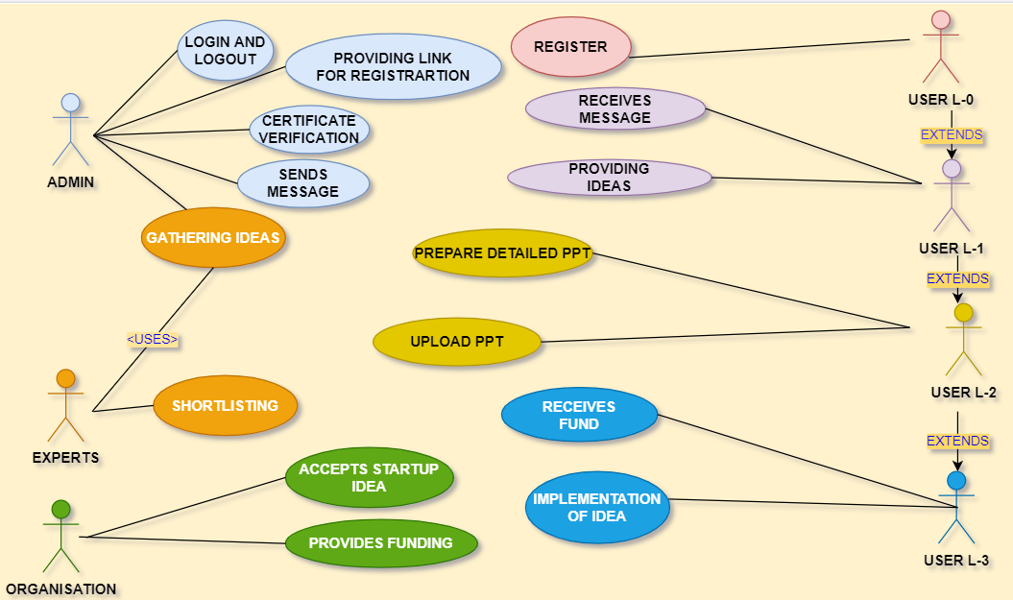
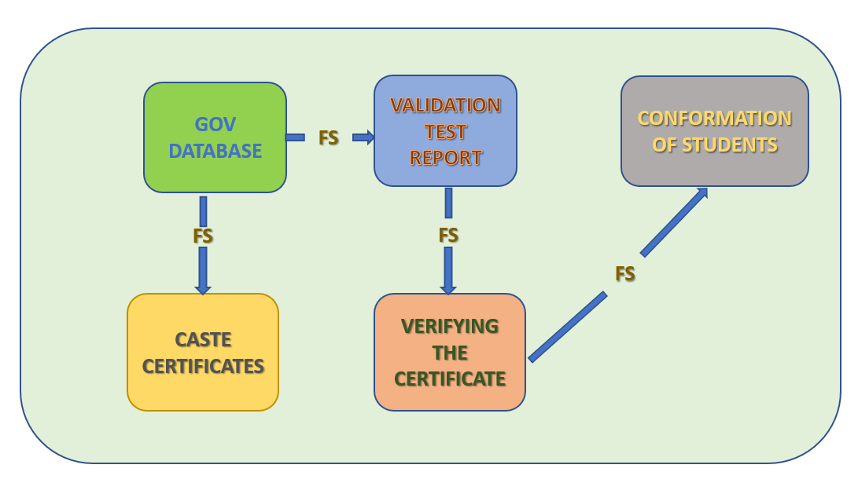
Idea/Approach Details
Use Case Diagram
Dependencies

Slide 4
Team Member Details
Team Leader Name: LAKKAKULA SAI HARSHITHA
Branch : BTECH Stream : CSE Year : II
Team Member 1 Name: KURIVELLA SAI SRI VIDYA
Branch : BTECH Stream : CSE Year : II
Team Member 2 Name: MADDIGUNTA PRADHYUMNA SAI
Branch : BTECH Stream : CSE Year : II
Team Member 3 Name: KURAPATI JAYASRI
Branch : BTECH Stream : CSE Year : II
Team Member 4 Name: KANDURI P V S S V VISHNU
Branch : BTECH Stream : CSE Year : II
Team Member 5 Name: KATHI RAKESH ADITHYA
Branch : BTECH Stream : CSE Year : II
Team Mentor 1 Name: Mr. NAGA SRIHARSHA MULUGU
Category : ACADEMIC Expertise : FULL STACK DEVELOPER Domain Experience : 10
Team Mentor 2 Name: Mr. PALLI R KRISHNA PRASAD
Category : ACADEMIC Expertise : AI Domain Experience : 16

